Slide 1
Bundle Tooltip
Ver 1.0

Slide 2
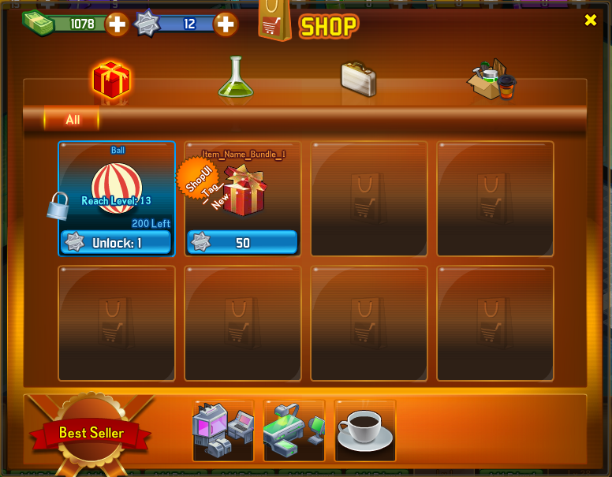


UI
Newcomer Bundle
Instant Coffee x 2
Instant Coffee x 2

Slide 3
How it works?
Notice
Notice + UI

Slide 4
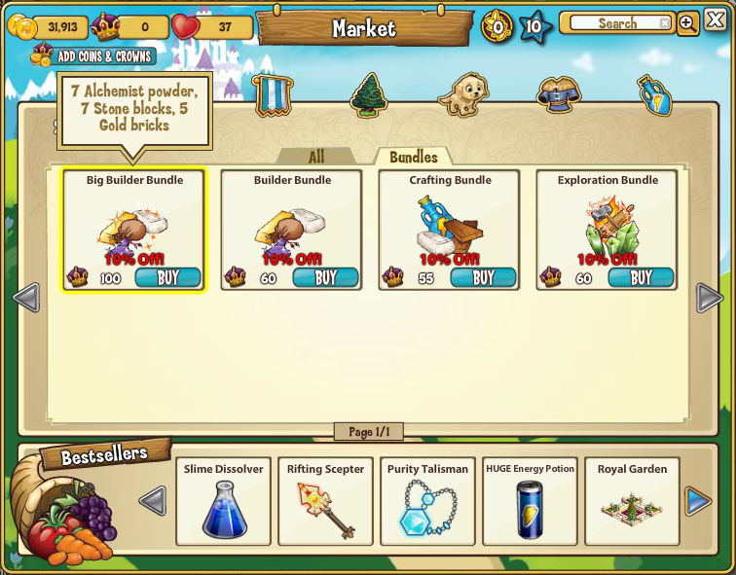
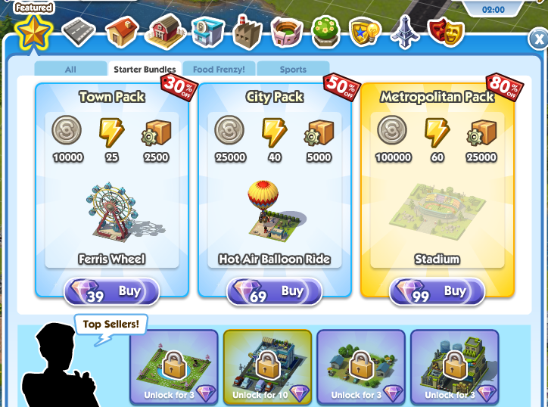
Reference

